Slide 1
Auto Insurance Data Project
File created on: 7/28/2025 11:55:36 PM

Slide 2
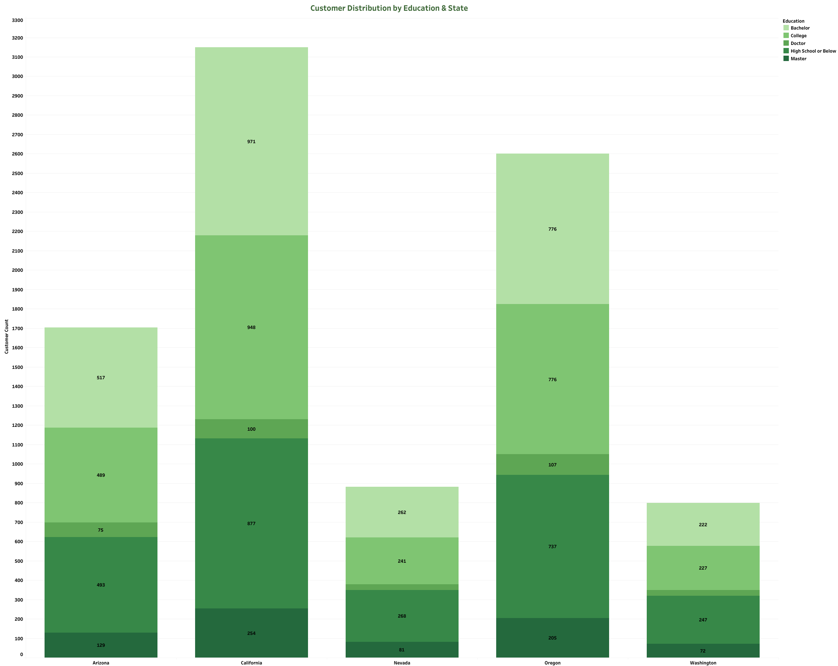

Slide 3
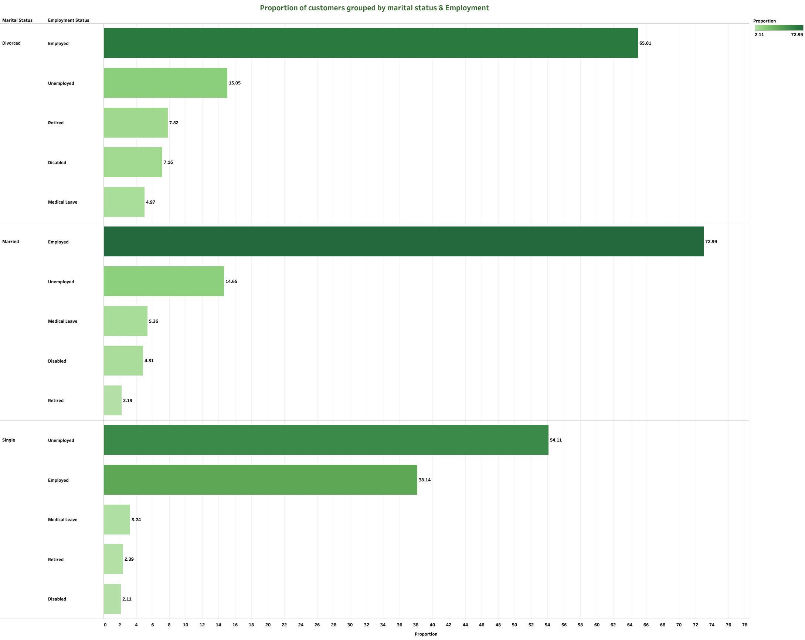

Slide 4
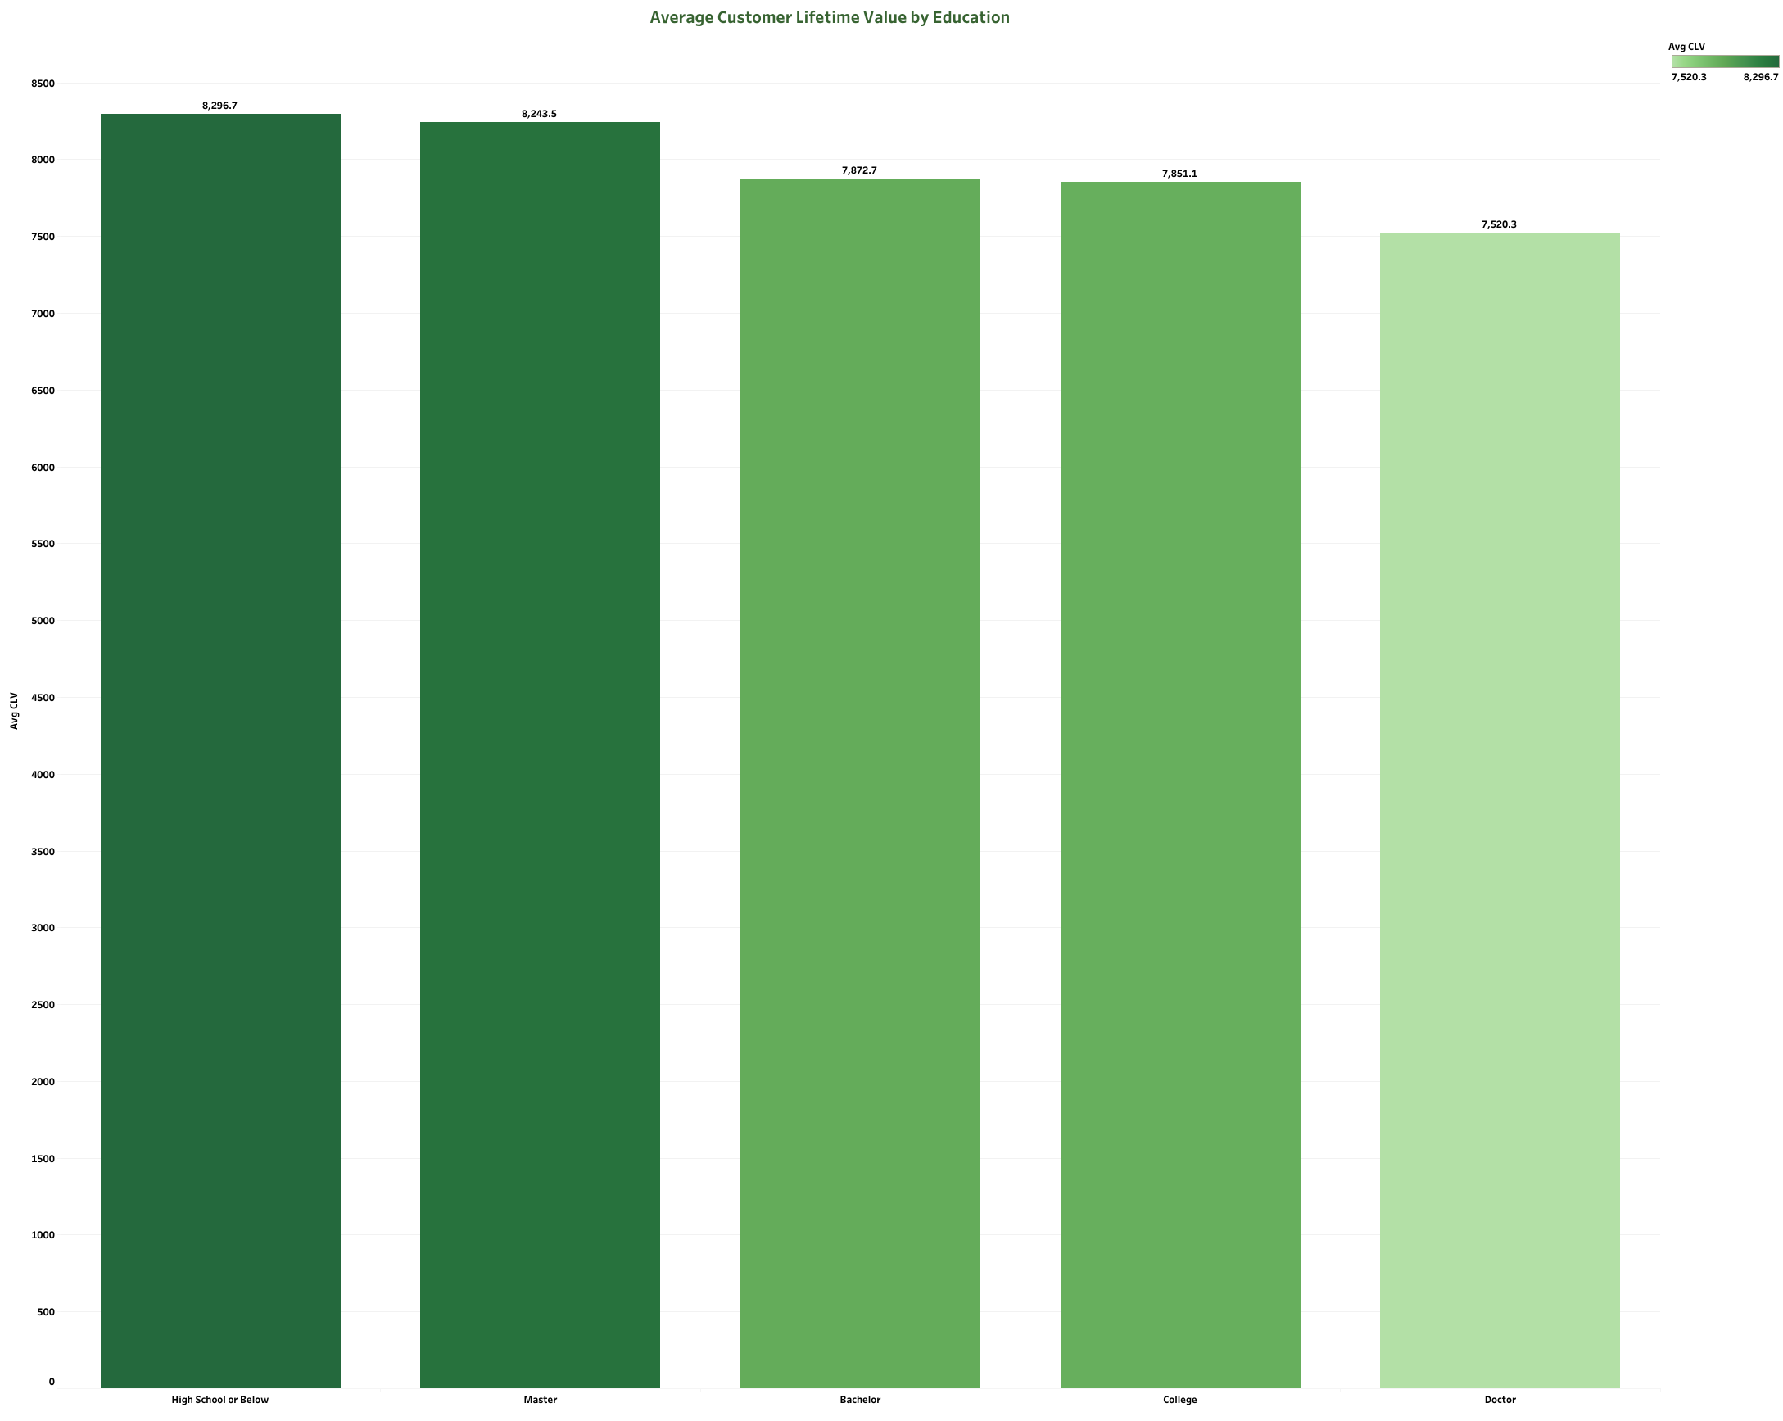

Slide 5
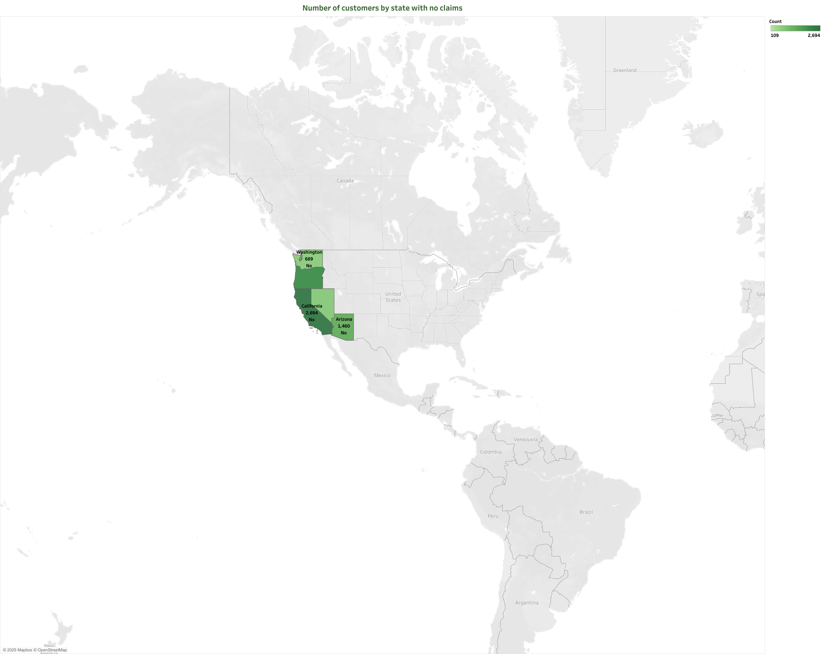

Slide 6
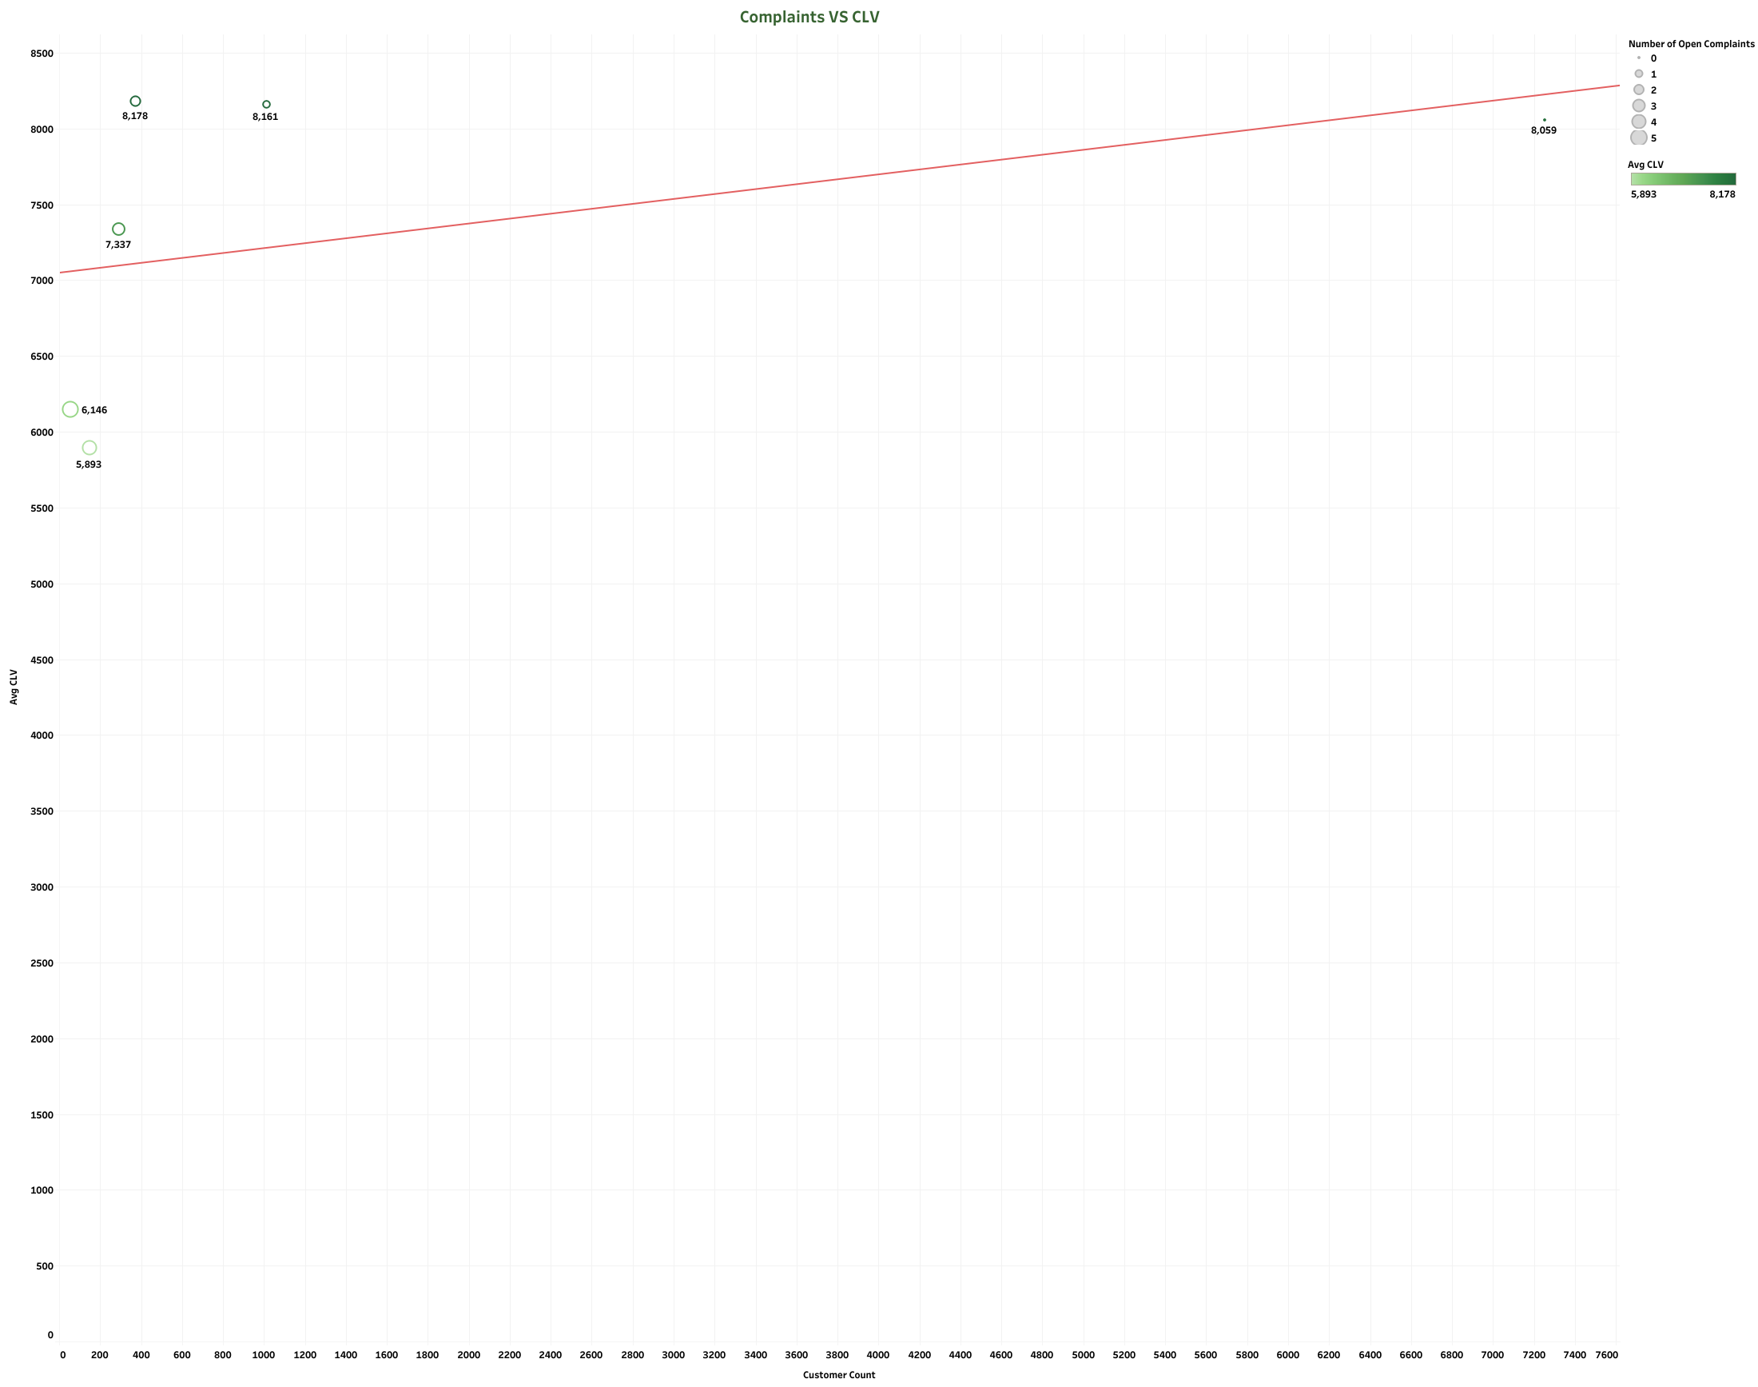

Slide 7


Slide 8
